Slide 1
Hands-On with Summit Workshop
Ashley Barker, Section Head for Operations, National Center for Computational Sciences

Slide 2
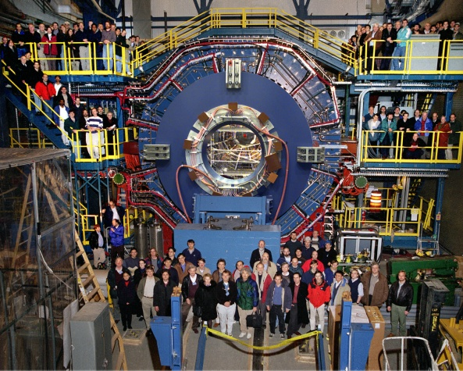
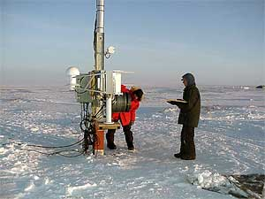
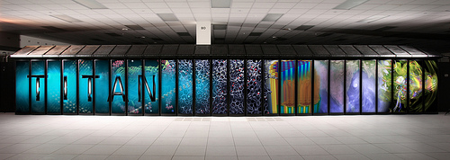
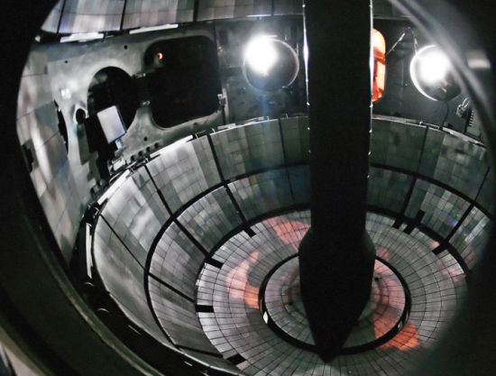
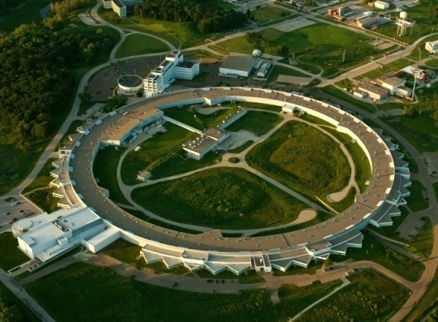
Office of Science User Facilities
28 world-leading facilities serving
over 33,000 researchers annually
supercomputers,
high intensity x-ray, neutron, and electron sources,
nanoscience facilities,
genomic sequencing facilities,
particle accelerators,
fusion/plasma physics facilities, and
atmospheric monitoring capabilities.
Open access; allocation determined through peer review of proposals
Free for non-proprietary work published in the open literature
Full cost recovery for proprietary work
http://science.energy.gov/user-facilities/user-facilities-at-a-glance/
2

Slide 3

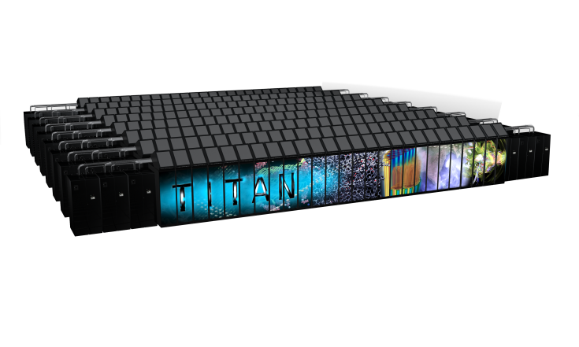

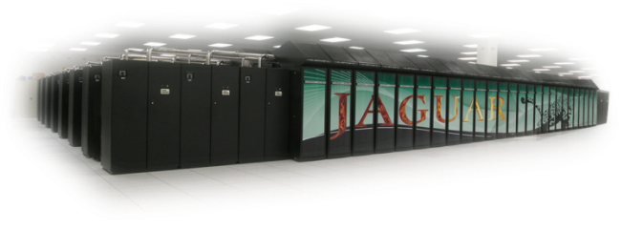
Oak Ridge Leadership Computing Facility – a DOE Office of Science User Facility
Mission: Providing world-class computational resources and specialized services for the most computationally intensive global challenges | Vision: Deliver transforming discoveries in energy technologies, materials, biology, environment, health, etc.
10¹⁸
Roadmap to Exascale
10¹⁷
10¹⁶
10¹⁵
Frontier
>1,500 PF
Hybrid GPU/CPU 29 MW
Summit
200 PF Hybrid GPU/CPU 13 MW
Titan: 27 PF Hybrid GPU/CPU 9 MW
Jaguar
2.3 PF Multi-core CPU 7 MW
2009
2012
2017
2021
Large part of success has been strong vendor and user partnerships to scale & refactor codes/methods

Slide 4
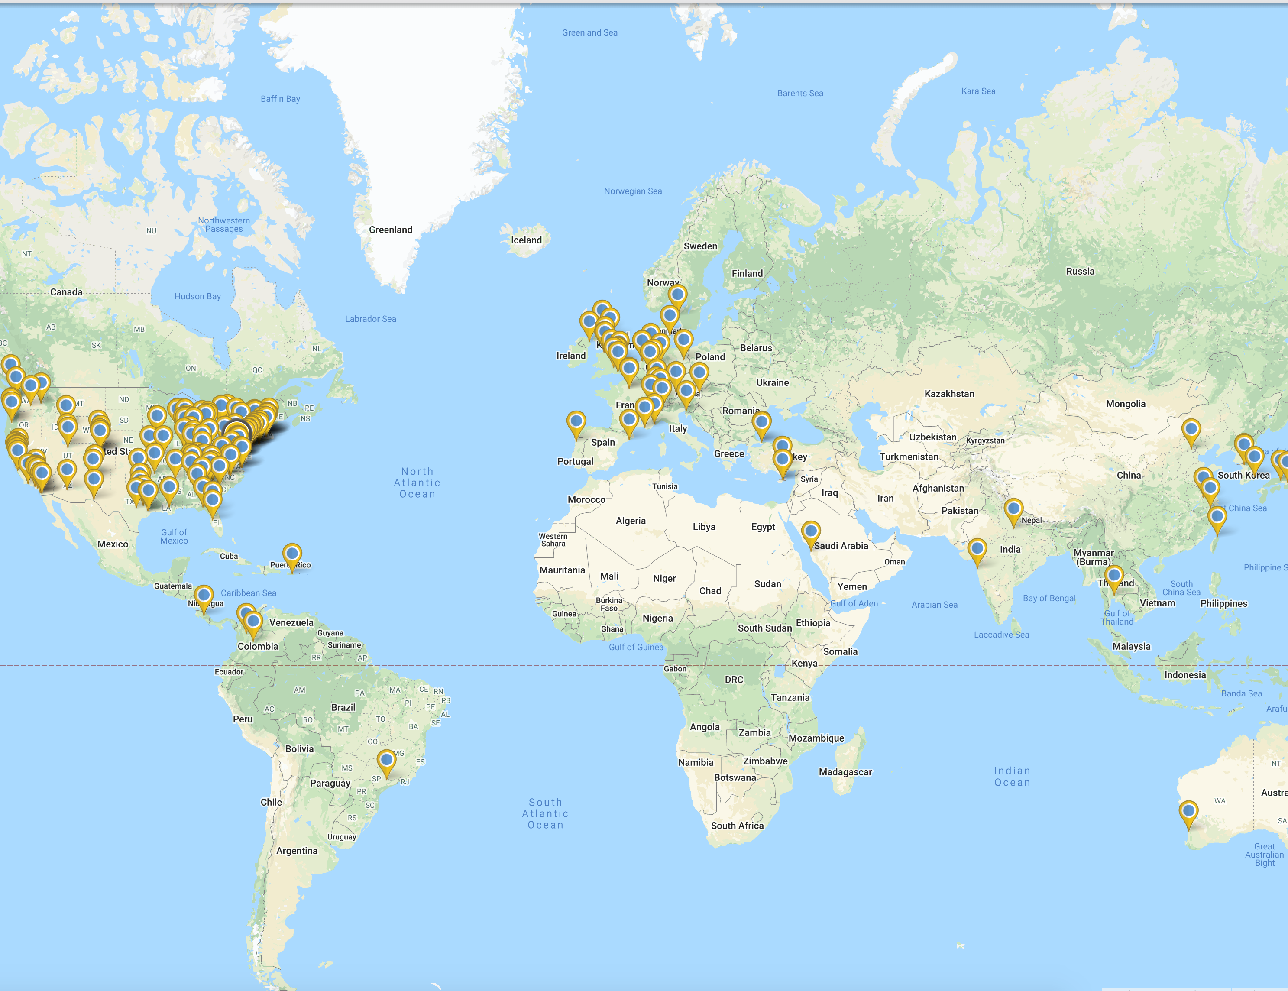
OLCF Users
The OLCF averages about 1,500 unique users who are located around the world
OLCF users come from academia, industry, and govt institutions
Users are attached to projects which run up to 3 years in duration. We average about 250 research projects per year.
OLCF resources are allocated through three highly competitive allocation programs requiring peer reviewed proposals

Slide 5
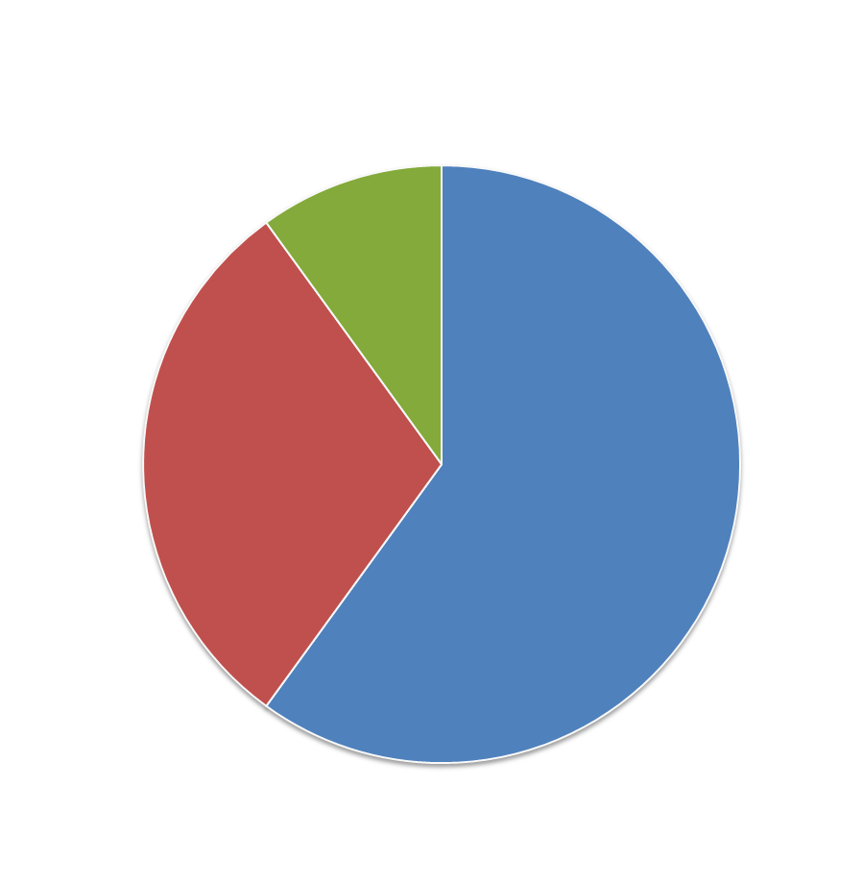




Three primary user programs for access to LCF Distribution of allocable hours
10% Director’s Discretionary
60% INCITE
Up to 30% ALCC
ASCR Leadership Computing Challenge
https://olcf.ornl.gov

Slide 6
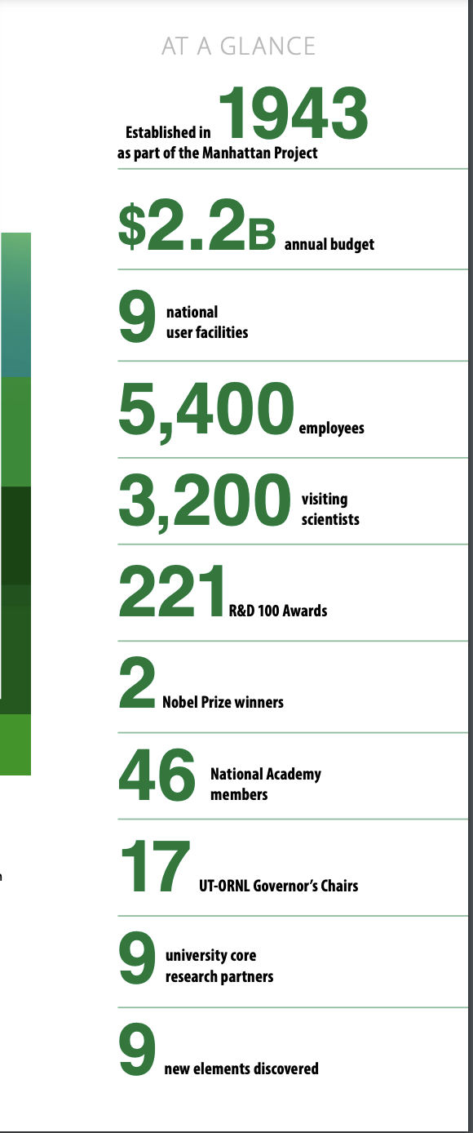
ORNL and the NCCS/OLCF are Hiring!
Oak Ridge National Laboratory has numerous scientific and technical positions available in HPC, AI, Computational Science and Mathematics
For a complete listing of positions available in Computing and Computational Sciences visit, https://jobs.ornl.gov/go/Computational-Sciences-Jobs/4534300/
Please join us for our first virtual Career Fair on Nov 11th, 1:30 pm – 5:30 pm ET

Slide 7

PEARC 22
https://pearc.acm.org/pearc22/

Slide 8
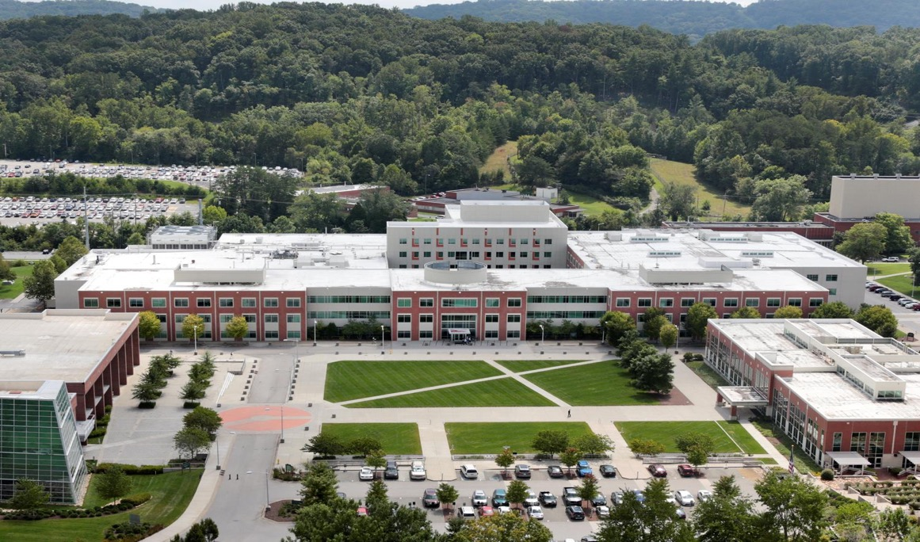
Questions?
Notes:
8

